Slide 1

SREENIDHI INSTITUTE OF SCIENCE AND TECHNOLOGY (AN AUTONOMOUS INSTITUTION Approved by UGC) Yamnampet, Ghatkesar, R.R. District -501 301 DEPARTMENT OF COMPUTER SCIENCE & ENGINEERING
Implementation Seminar
On
MATLAB GUI TOOL FOR TUMOR MRI IMAGE ENHANCEMENT
By:
Ch.Likitha Reddy 16311A0513
K.Harshini 16311A0524
T.Madhuvani 16311A0559
Internal guide Project Co-ordinator Head of Department
Dr.T.V. Rajini kanth Mrs. P. Vasavi Dr. Aruna Varanasi
Professor,Dean R&D Assistant Professor Professor & HOD
Department of CSE Department of CSE Department of CSE

Slide 2
contents
Abstract
Introduction
Existing system
Proposed System
Software & Hardware Requirements
UML Diagrams
Algorithm
Framework
Process of Execution
Outputs
Applications
Conclusion
Future Enhancement
Reference

Slide 3
Abstract
Present day life styles are causing Tumors at the early age of Human Beings.
It is an abnormal growth of tissue, a classic illustration of inflammation which can be benign or malignant (cancerous). Early detection of tumors holds the key in the efficient treatment of many cancers.
In recent times, technological advancements in image processing techniques made researchers to deploy in order to enhance the image quality for earlier detection and treatment stages especially in various lung cancer tumors.
Globally, cancers are predominantly causes deaths in men and women and most of them are Lung, Brain and Prostate, etc. tumors are malignant in nature.
Since Tumors are highly vascular, these tumors destroy healthy tissues around them and invade other organs.
If detected early, most of such patients can survive and in some cases with little or no recurrence even after five years.

Slide 4
ABSTRACT
In the light of the above facts, an Image processing tool was designed and developed to apply around 17 image filtering techniques like Mean, Median, Gaussian, Wiener etc using MATLAB to enhance the MRI tumor image quality
In order to detect tumor accurately one of the Segmentation techniques namely Global Threshold is used.
This tool is useful to doctors in diagnosis phase for early detection of tumor to save the patient by appropriate treatment.
Apart from that the performances of various filters were also estimated using MSE, PSNR and SSIM values.

Slide 5
Introduction
Tumor is an abnormal growth of tissue, a classic manifestation of inflammation which could be benign or malignant (cancerous). Tumors are of many types with various names. Usually, the names reflect the origin, shape and the type of tissue they begin. Generally, tumors are classified into three types as given below:
Benign tumors.
Pre-malignant tumors.
Malignant tumors.
Benign Tumors:
Benign tumors are non- cancerous and are predominantly localized in its existing appearance. They do not recur up on surgical excision. There are different types of benign tumors like adenomas, fibromas, hemagiomas, lipomas, moles, neuromas, osteochondromas and papillomas.
Premalignant Tumors: Although a premalignant tumor is not carcinogenic but it is in the process of acquiring the cancer properties.
Malignant Tumors: These tumors are cancerous that have the ability to indefinitely grow, spread and cause secondary tumors in other tissues through metastasis. They ultimately lead to the death of the patient.

Slide 6
INTRODUCTION
Various malignant tumors originate from specific types of cancer cells. They are:
Carcinomas are known to originate from epithelial cells. Most of the common tumors are carcinomas, especially among older adults. Eg., carcinomas of the stomach, liver, pancreas, colon, prostate, lung or breast
Sarcomas start in connective tissues like bones, cartilage, fat and nerves. They originate in the cells outside the bone marrow and majority of them are malignant.
Germ cell tumor: These tumors originate from the sperm and egg cells. Germ cell tumors most commonly occur in the ovaries or testicles.
Blastomas: These tumors are more common in children and formed from embryonic tissue or developing cells. Eg., medulloblastoma and glioblastoma, (brain tumors), retinoblastoma (tumor in the retina of the eye), osteoblastoma, (bone tumor), and neuroblastoma (tumor of the nervous system).

Slide 7
Existing system
In the existing system only two to three filtering techniques are used namely Mean filter and Median filter
It is only to enhance the quality of the MRI image

Slide 8
Proposed System
In this 17 types of Filtering techniques including the existing techniques are used namely Mean, Median, Wiener, Gaussian etc are used
Comparison of performances of Filters will be made using MSE, PSNR and SSIM techniques

Slide 9
SOFTWARE REQUIREMENTS:
OS - Windows 7/8/10
Software - MATLAB 2016a

Slide 10
HARDWARE REQUIREMENTS:
Processing Unit - Intel Core i5
CPU Speed - 1.6 Gigahertz
RAM - 2048 Megabytes (Minimum)
HDD Size - 1 Gigabytes
Display Unit - SVGA/LCD/LED

Slide 11
DATA FLOW DIAGRAM
LOAD IMAGE
CONVERSION TO GRAYSCALE IMAGE
IMAGE FILTERING TECHNIQUES
IMAGE COMPARISON METRICS
COMPARISON OF RESULTS

Slide 12
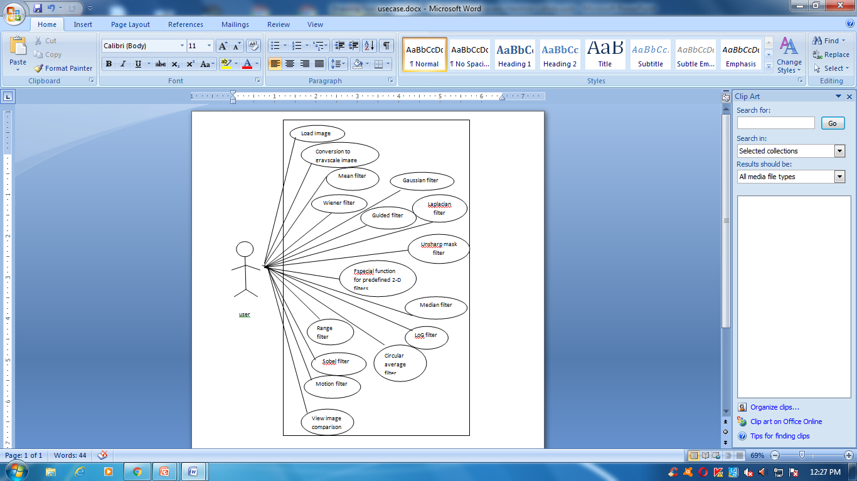
Use Case diagram

Slide 13
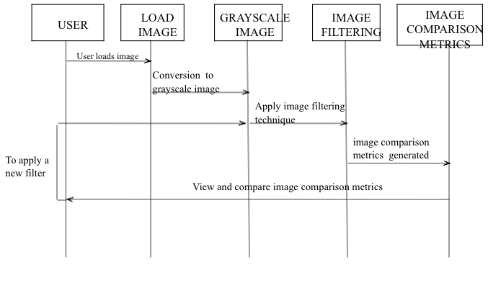
sequence Diagram

Slide 14
Algorithm & Model
This algorithm consists of three main parts:
1. conversion of input image into grayscale.
2. applying image filters.
3. Comparison of image comparison metrics.
STEP 1 - Read input image.
The MRI tumor image which has to be enhanced for tumor detection is to be loaded.
STEP 2 – convert to gray scale image.
The image loaded in the previous step is converted to graysacle image for further processing.

Slide 15
Algorithm:
STEP 3 – applying image filters.
In this project a total of 17 image filtering techniques have been implemented for the image enhancement. These filters can be applied by pressing the respective buttons and the resultant image is displayed.
STEP 4 – comparison of image comparison metrics.
Image comparison metrics like MSE, PSNR and SSIM values are generated for each filter and a comparison can be drawn between various filters.

Slide 16
The list of filters implemented are given below:
1. Median filter 10. Min filter
2. Laplacian filter 11. Unsharp masking filter
3. Ordered filter 12. Average filter
4. Sobel filter 13. Disk filter
5. Max filter 14. Gaussian filter
6. Weiner filter 15. Midpoint filter
7. Guided filter 16. Low pass filter
8. Motion filter 17. Gabor filter
9. LOG filter

Slide 17
framework
MATLAB is a high-level language and interactive environment for numerical computation, visualization, and programming. Using MATLAB, we can analyze data, develop algorithms, and create models and applications.
The Image Processing Toolbox is a collection of functions that extend the capability of the MATLAB numeric computing environment. These functions, and the expressiveness of the MATLAB language, make image-processing operations easy to write in a compact, clear manner, thus providing an ideal software prototyping environment for the solution of image processing problems.

Slide 18
Process of Execution:
The first step is to load the image into the project using load image button and it is displayed in the axes1 region.
Next the loaded image is to be converted into grayscale by pressing rgb to gray button and the resultant image is displayed in axes2 region.
Then the filtering techniques are to be applied by pressing the respective buttons and the filtered image is displayed In the axes3 region.
The image comparison metrics generated for each filter are displayed in the matlab command window and can be compared with other filters to choose the best one.

Slide 19
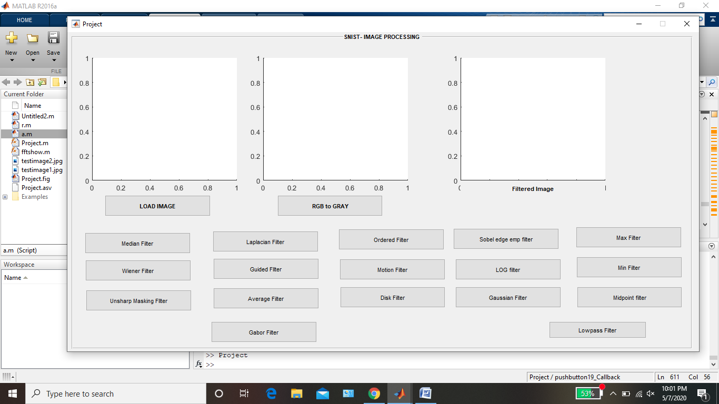
OUTPUT SCREENSHOTS

Slide 20
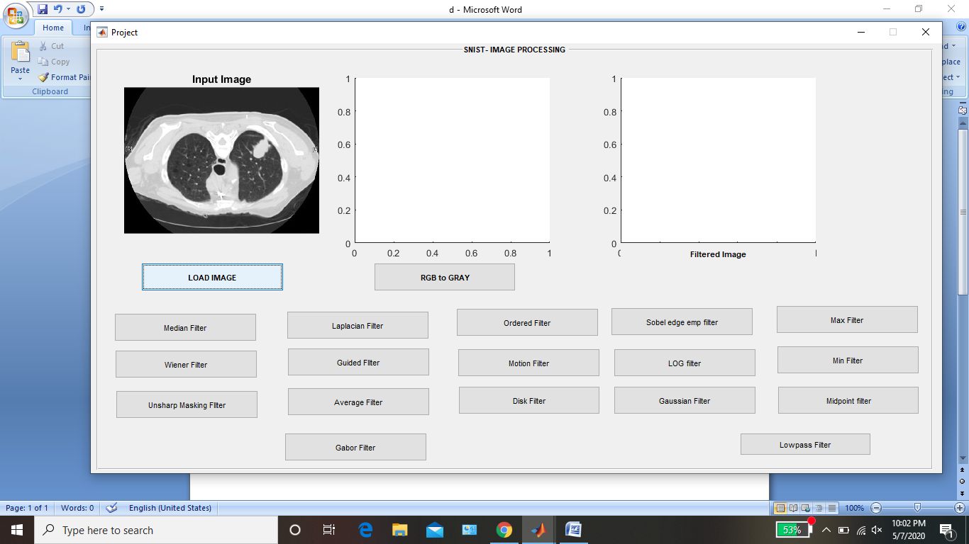
LOAD IMAGE

Slide 21
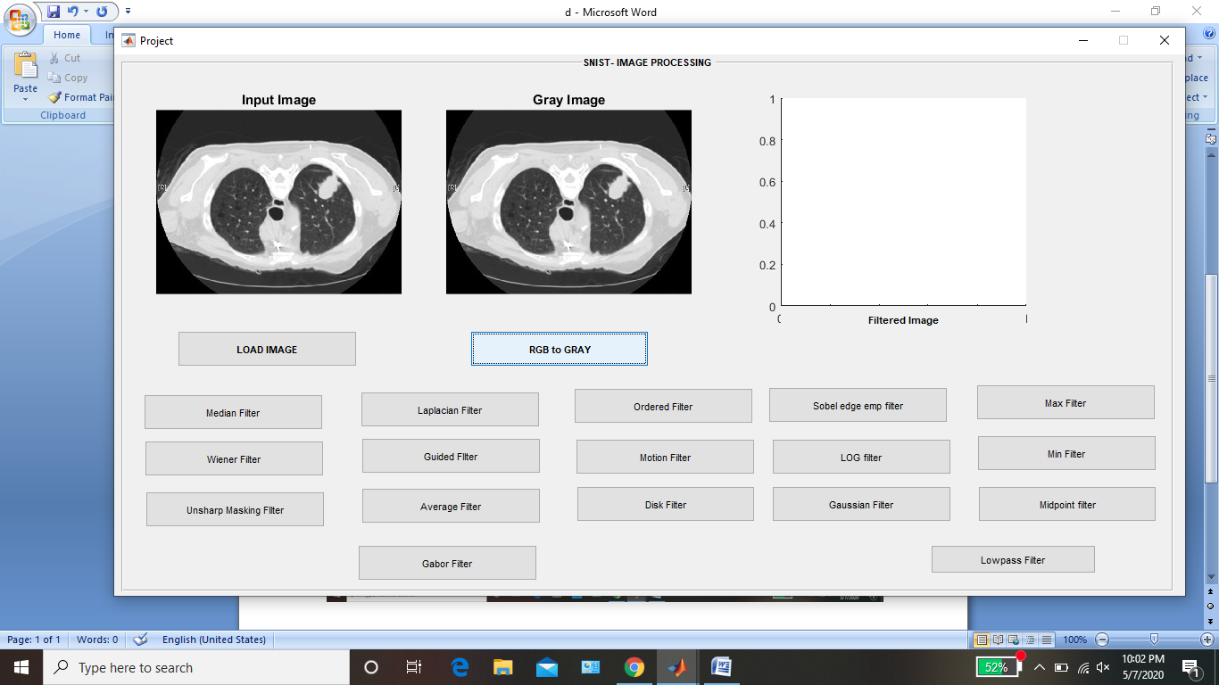
RGB to gray

Slide 22
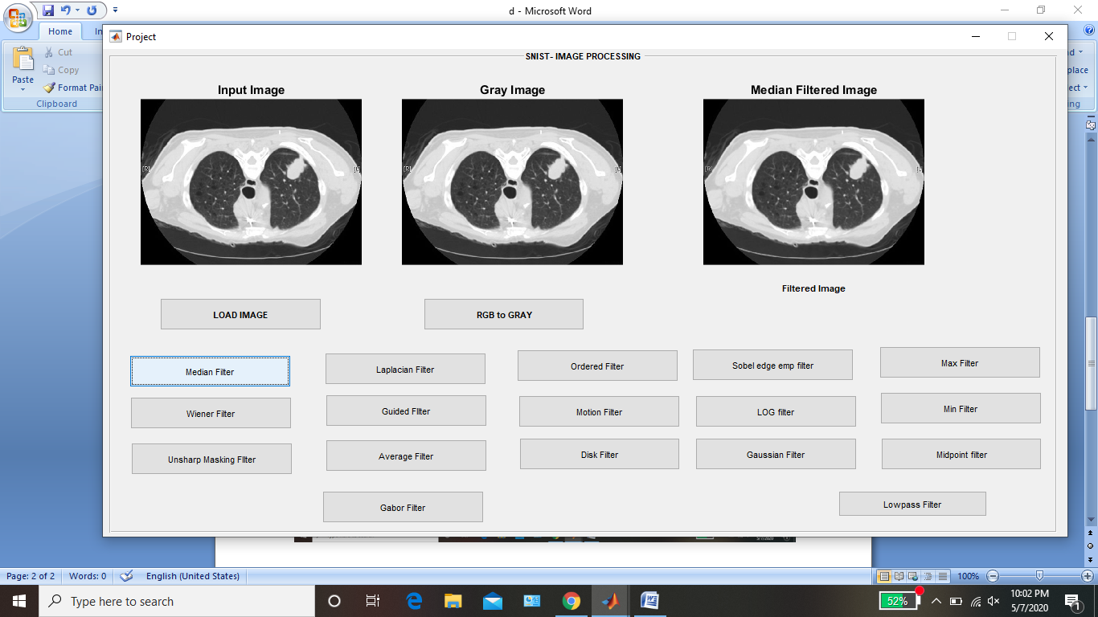
Median filter

Slide 23
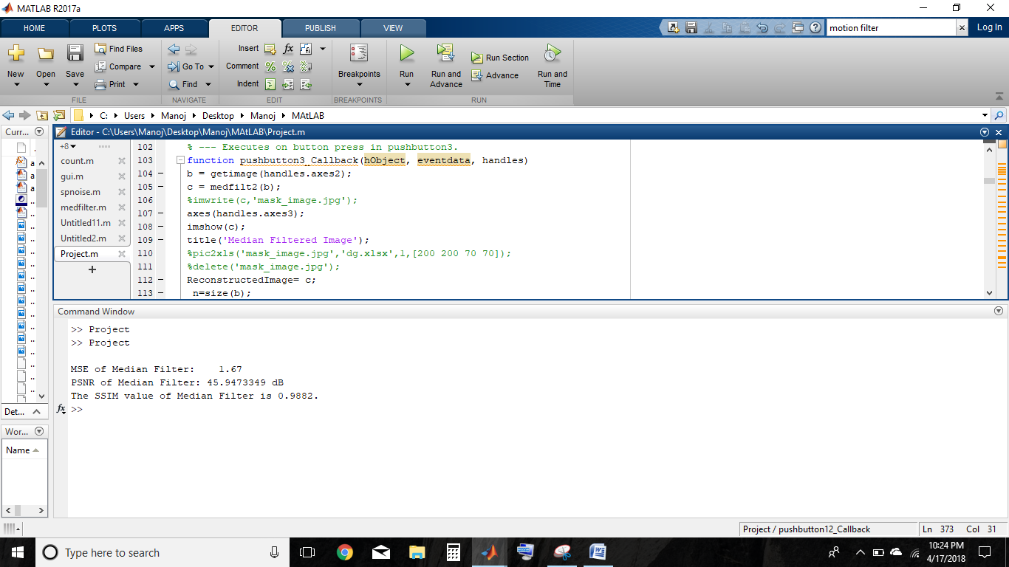
Image comparision metrics for median filter

Slide 24

Wiener filter

Slide 25

Image comparison metrics for wiener filter

Slide 26
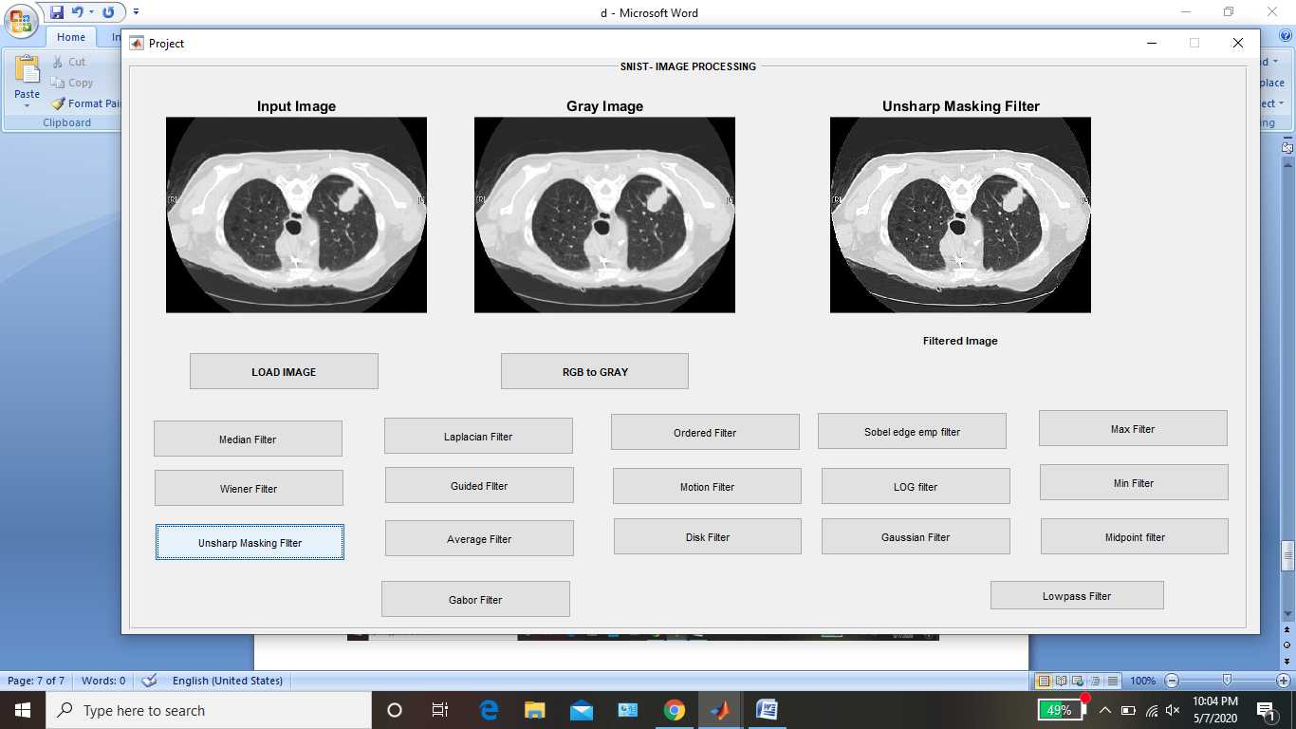
Unsharp masked filter

Slide 27
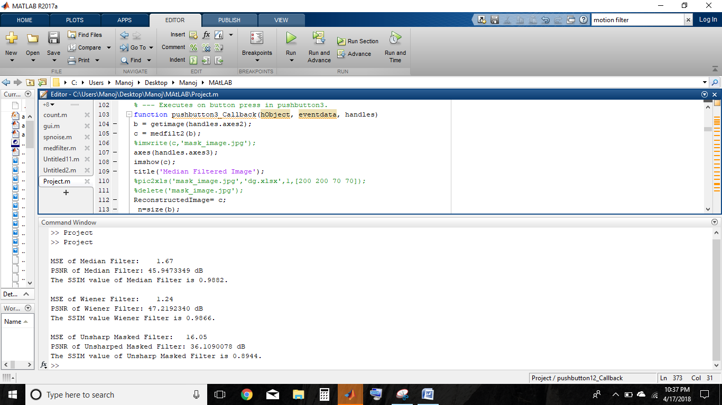
Image comparison metrics for unsharp masked filter

Slide 28
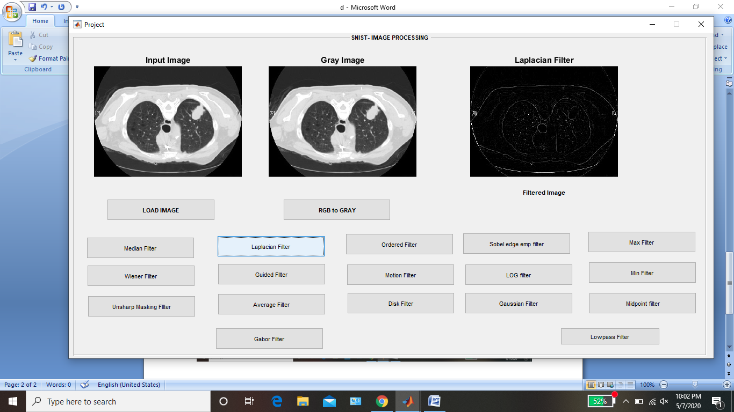
Laplacian filter

Slide 29
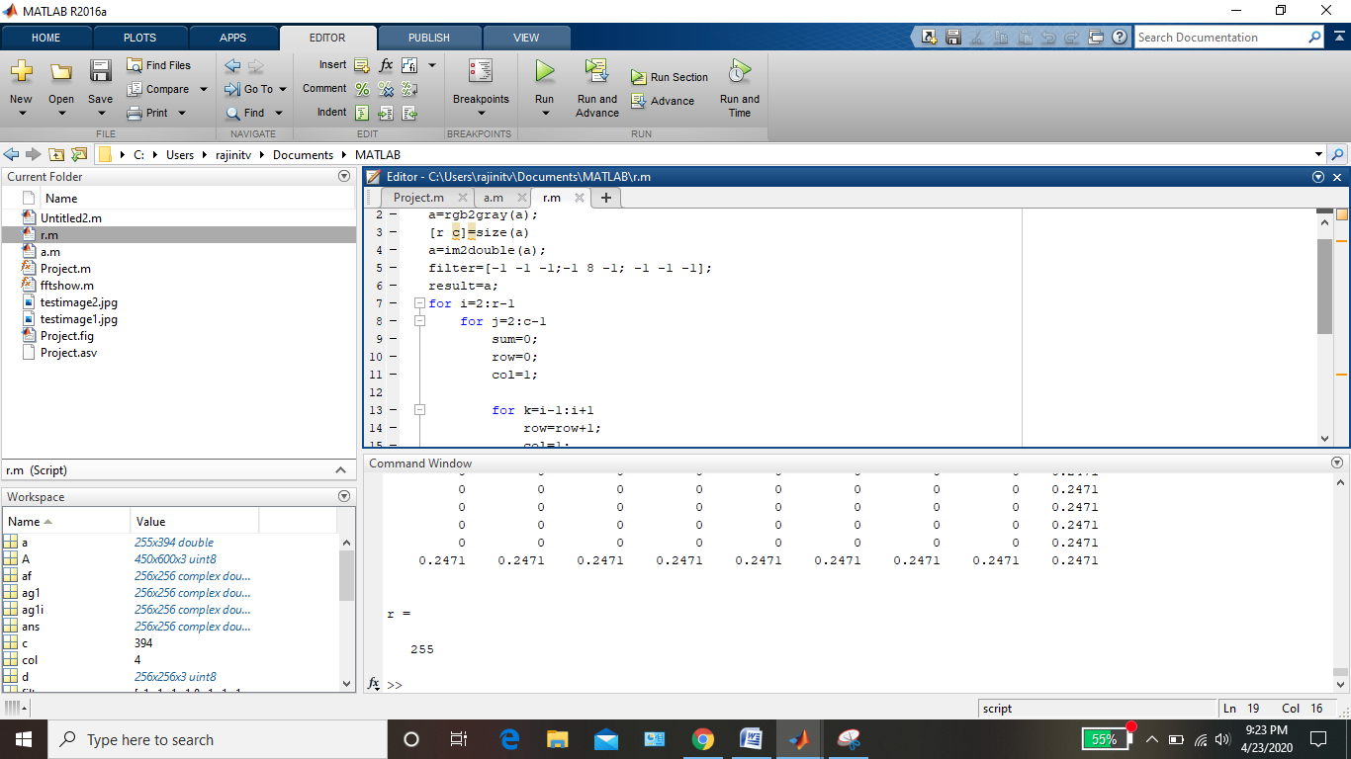

Image comparison metrics for Laplacian filter

Slide 30
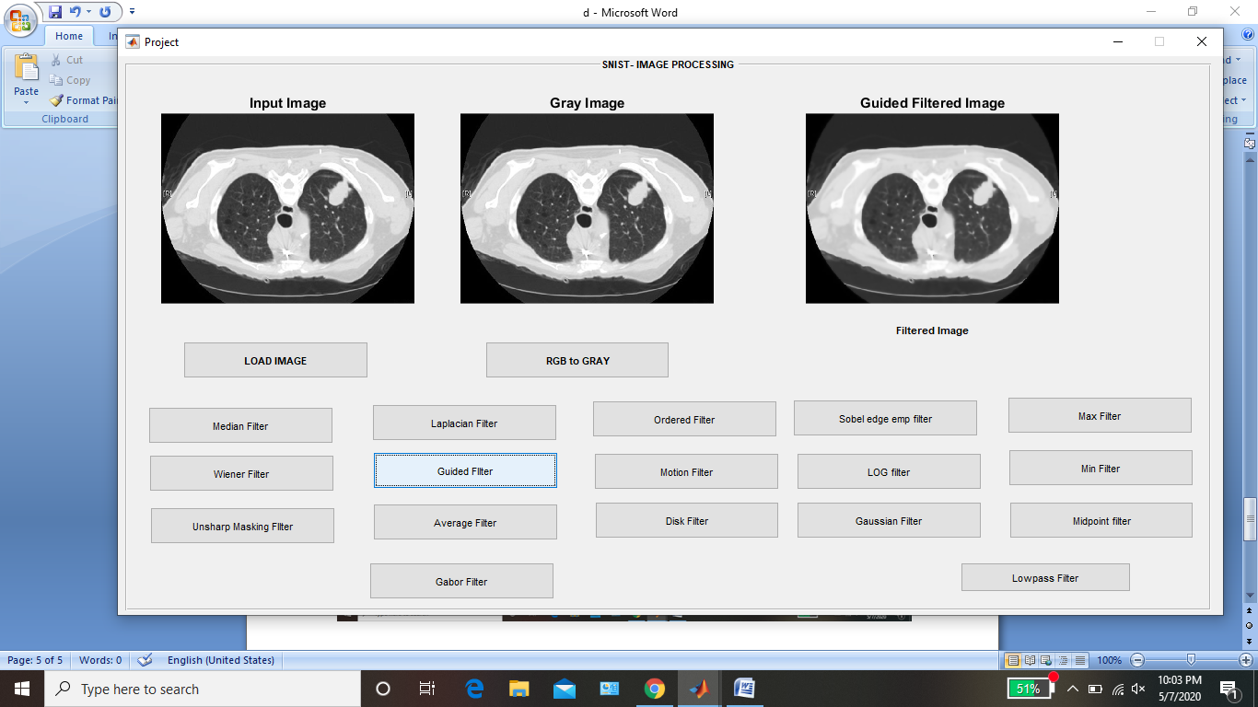
Guided filter

Slide 31
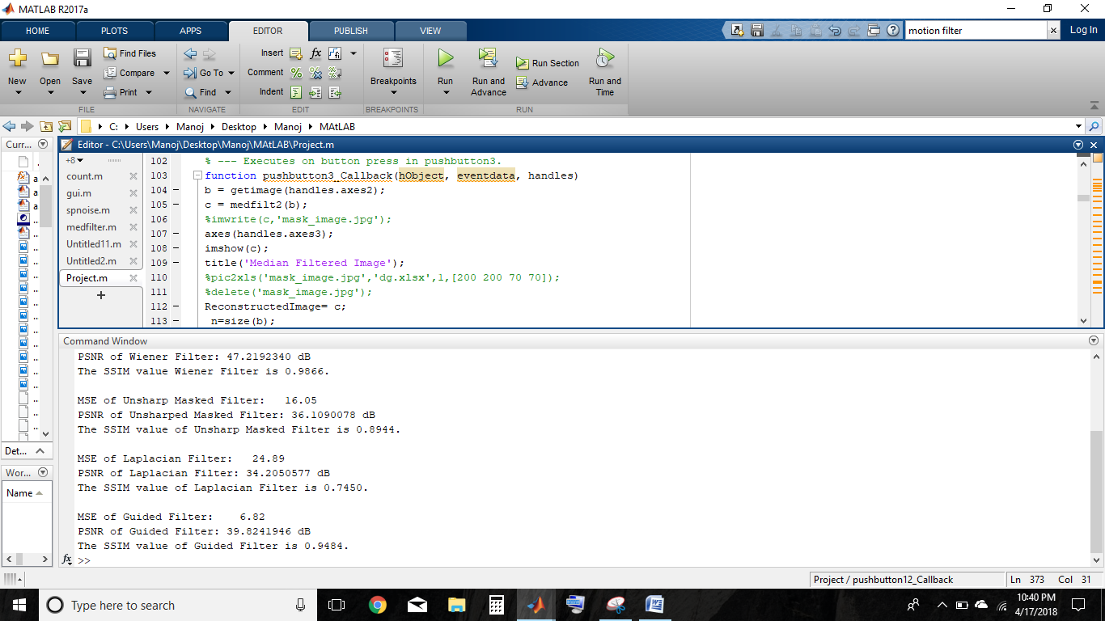
Image comparison metrics for guided filter

Slide 32

Average filter

Slide 33

Image comparison metrics for average filter

Slide 34
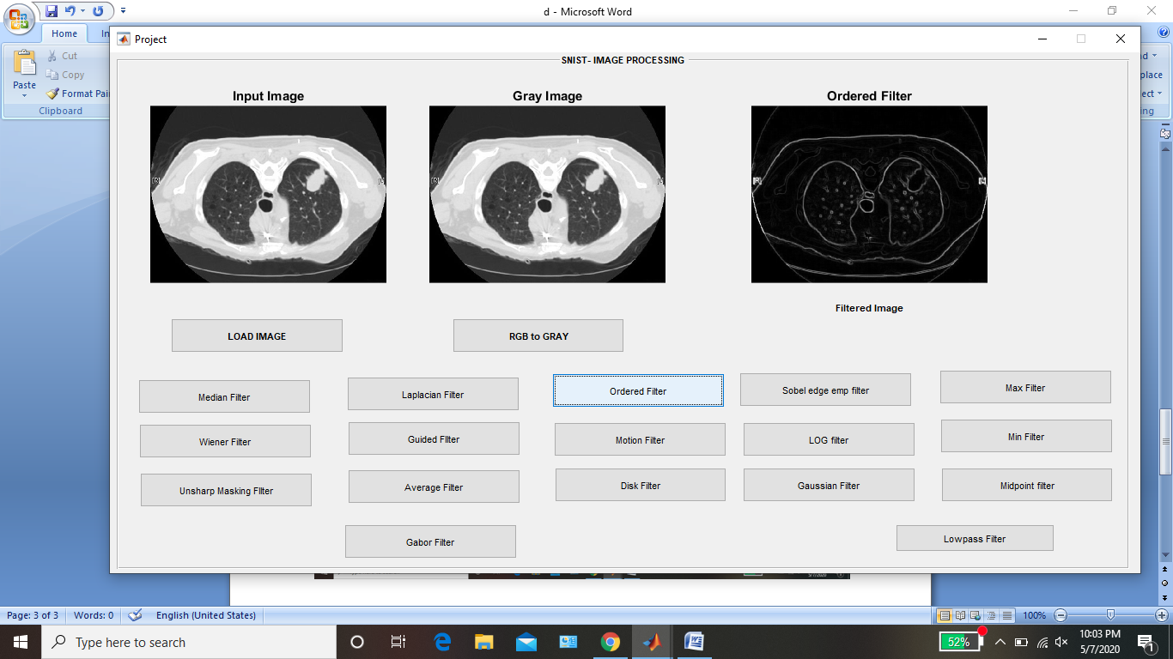
Range filter

Slide 35
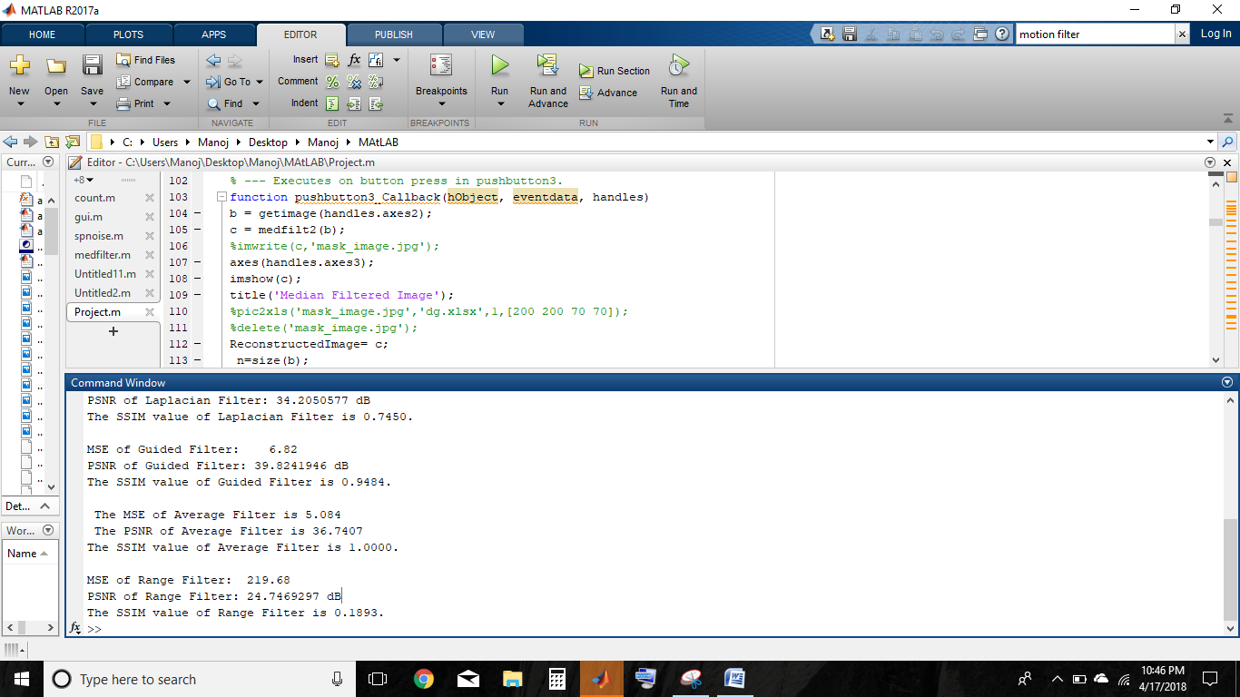
Image comparison metrics for range filter

Slide 36

Motion filter

Slide 37
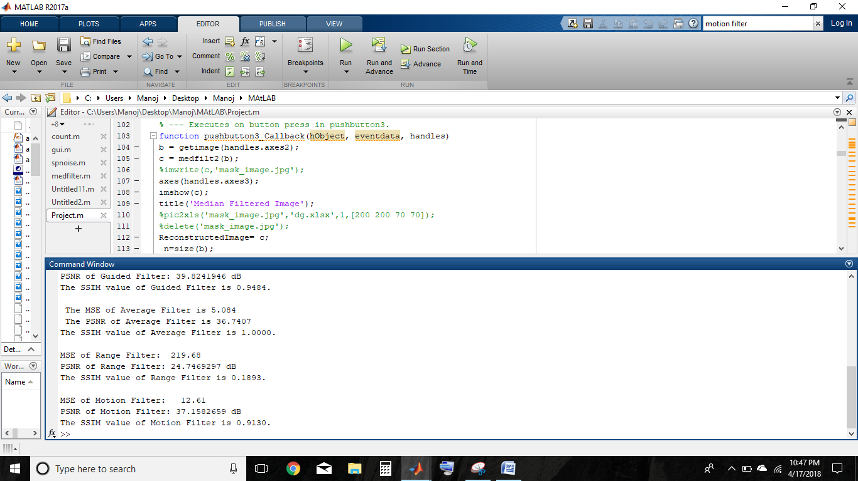
Image comparison metrics for motion filter

Slide 38
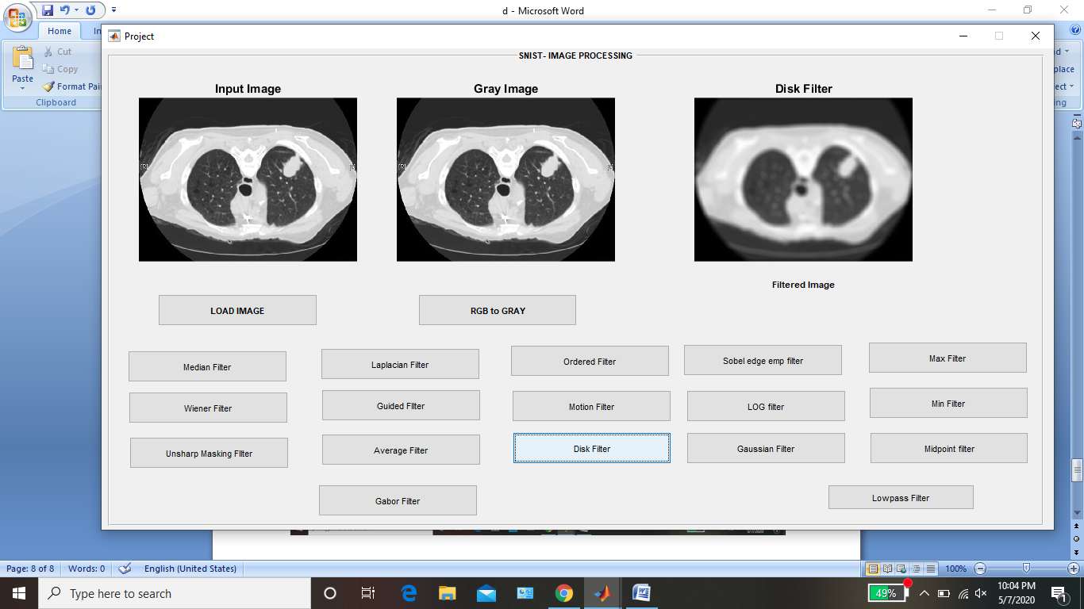
Disk filter

Slide 39
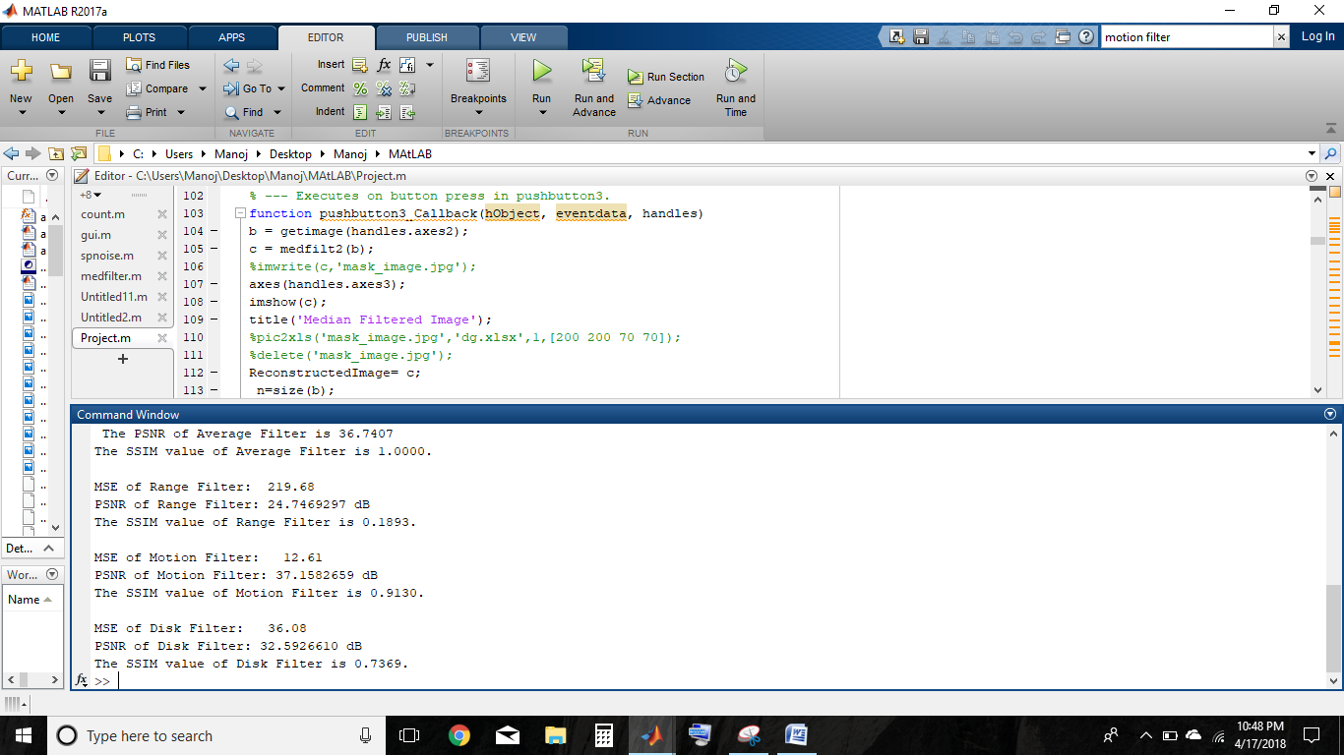
Image comparison metrics for disk filter

Slide 40
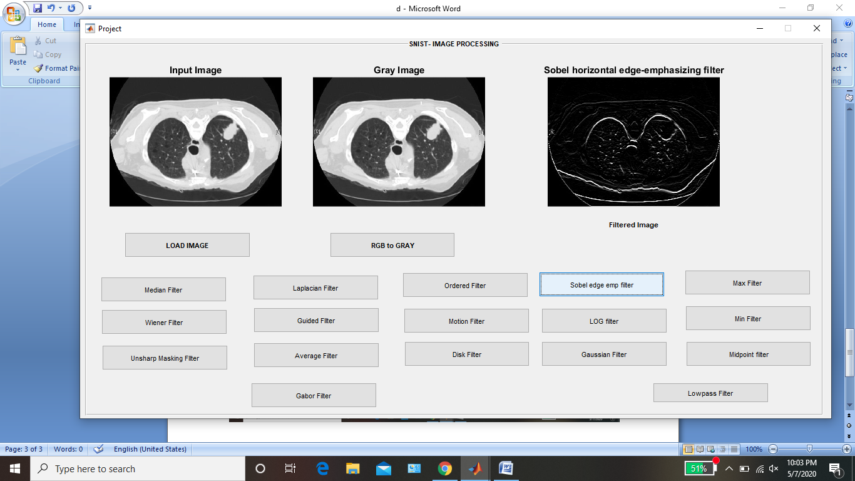
Sobel filter

Slide 41
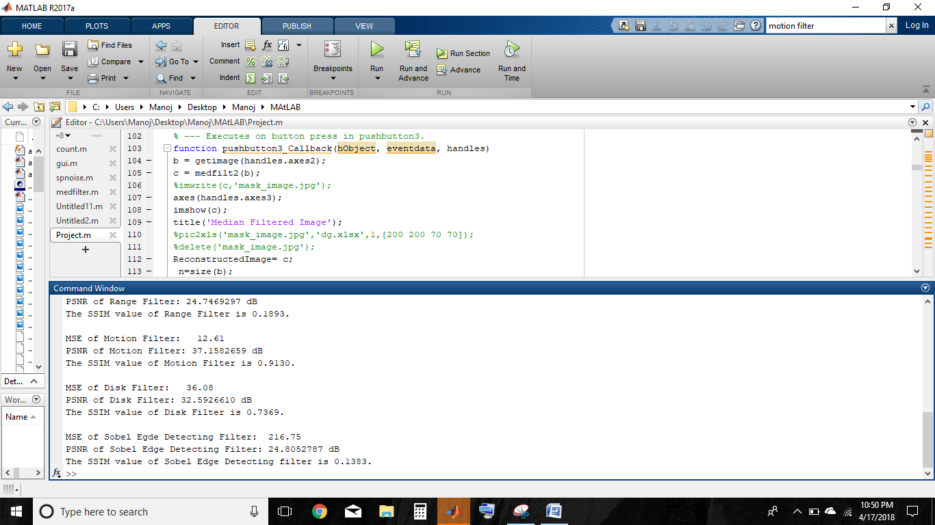
Image comparison metrics for sobel filter

Slide 42

Log filter

Slide 43
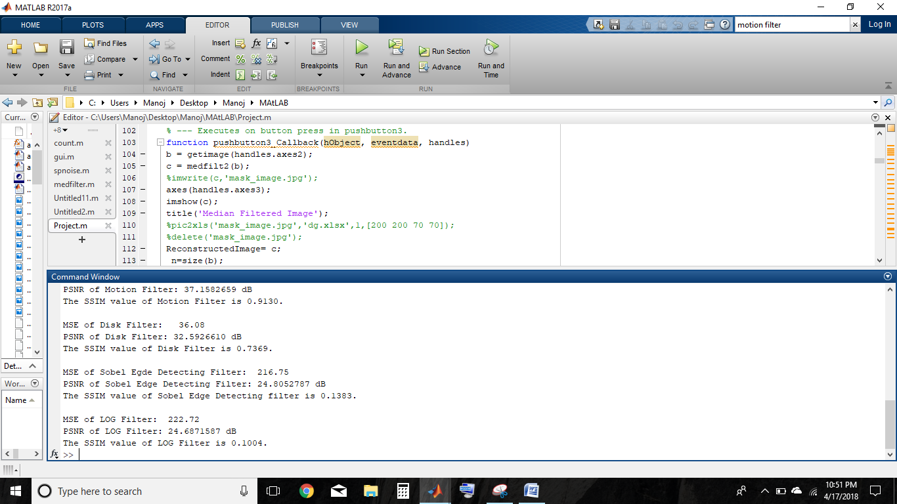
Image comparison metrics for Log filter

Slide 44

Gaussian filter

Slide 45

Image comparison metrics for gaussian filter

Slide 46
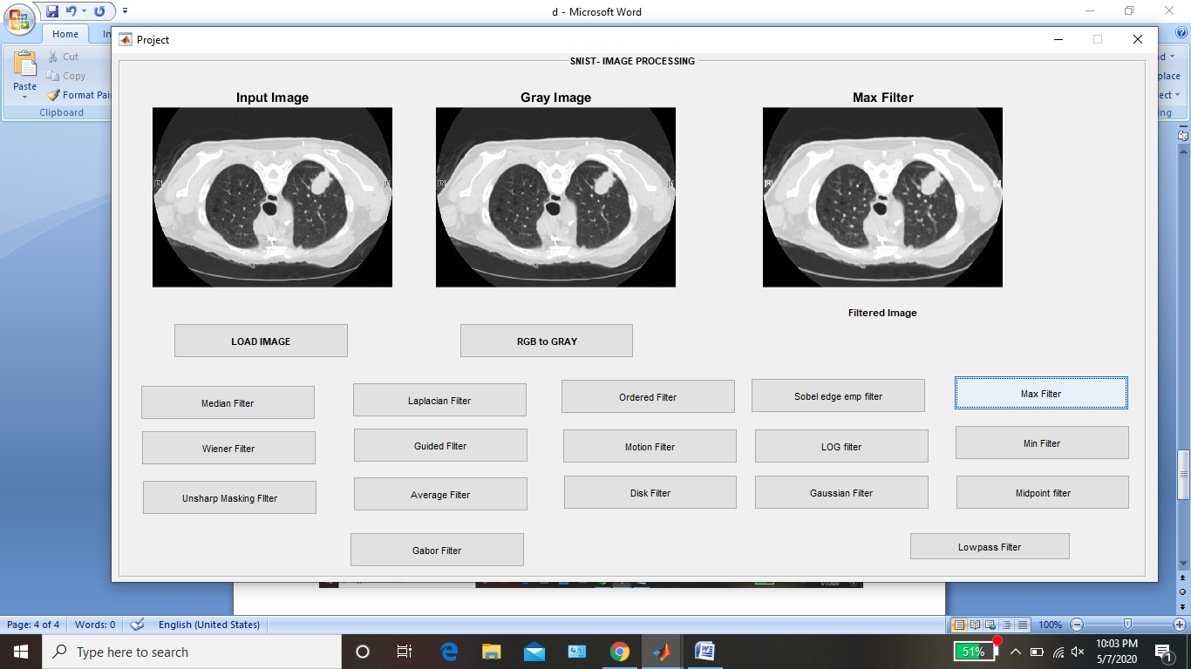
Max filter

Slide 47

Image comparison metrics for max filter

Slide 48
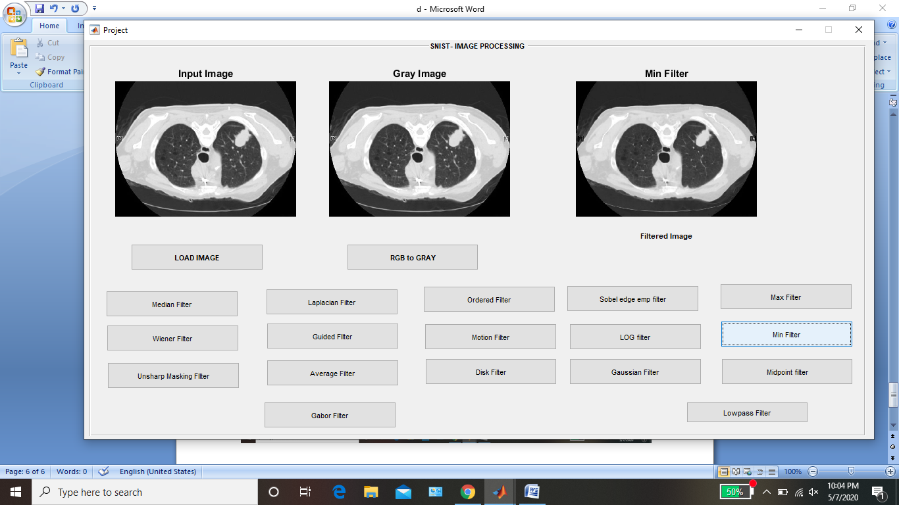
Min filter

Slide 49
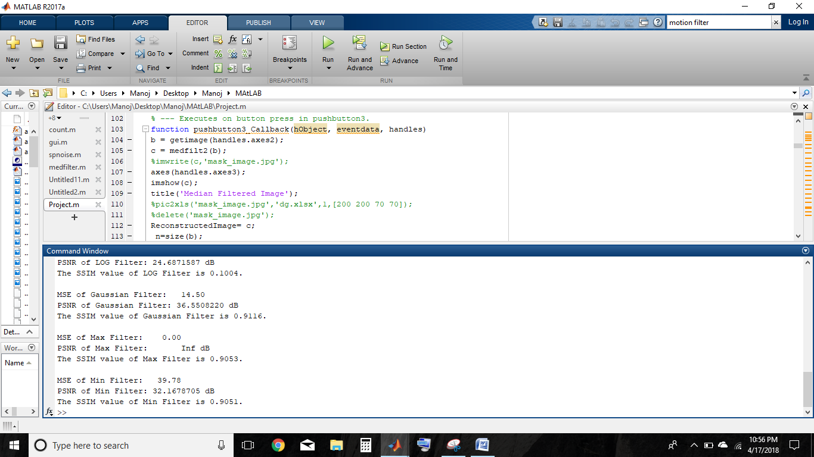
Image comparison metrics for min filter

Slide 50

Midpoint filter

Slide 51
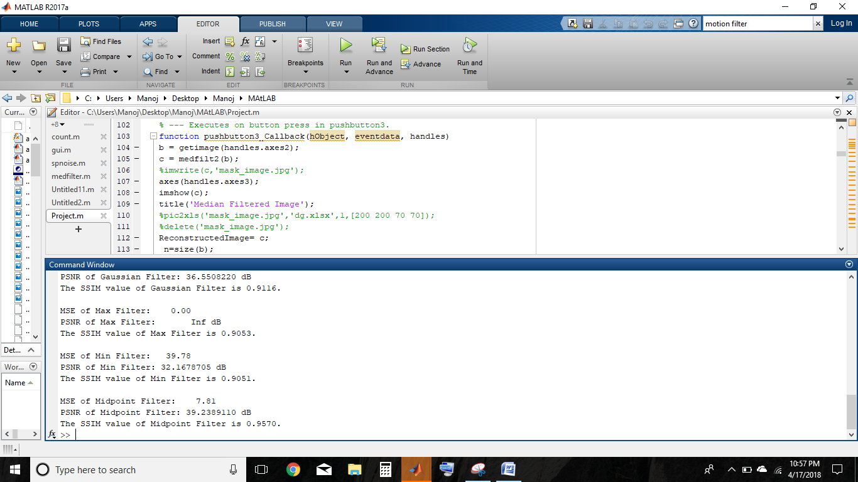
Image comparison metrics for midpoint filter

Slide 52
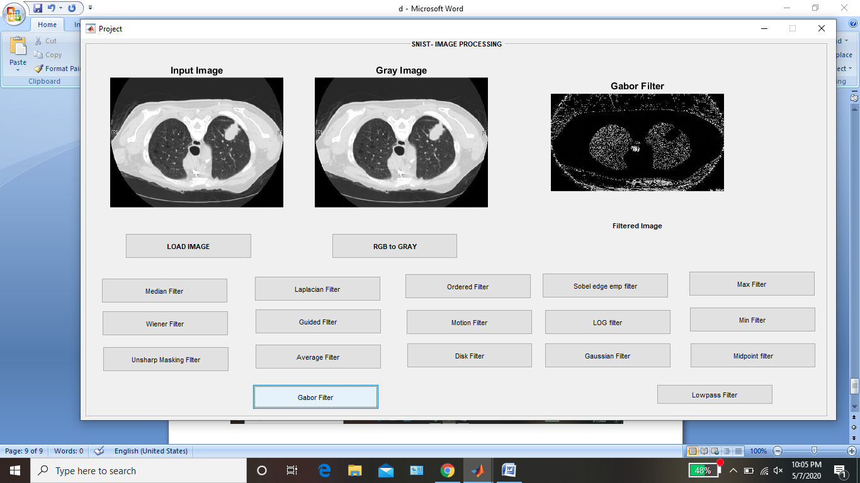
Gabor filter

Slide 53
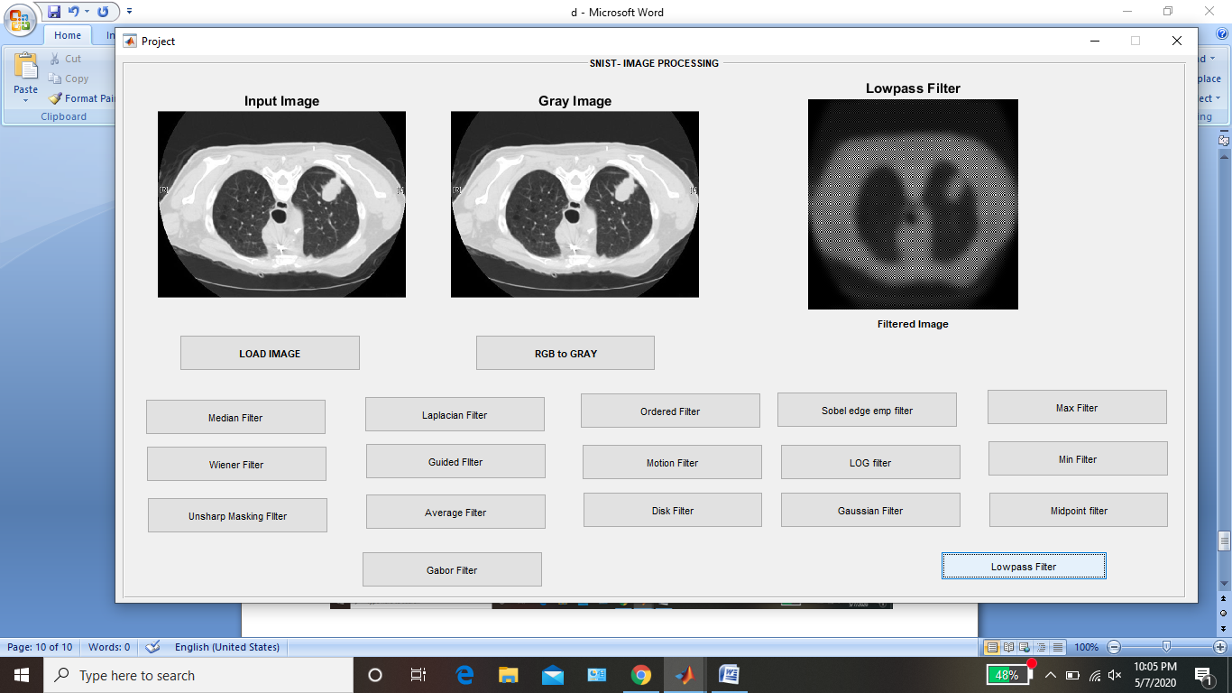
Lowpass filter

Slide 54
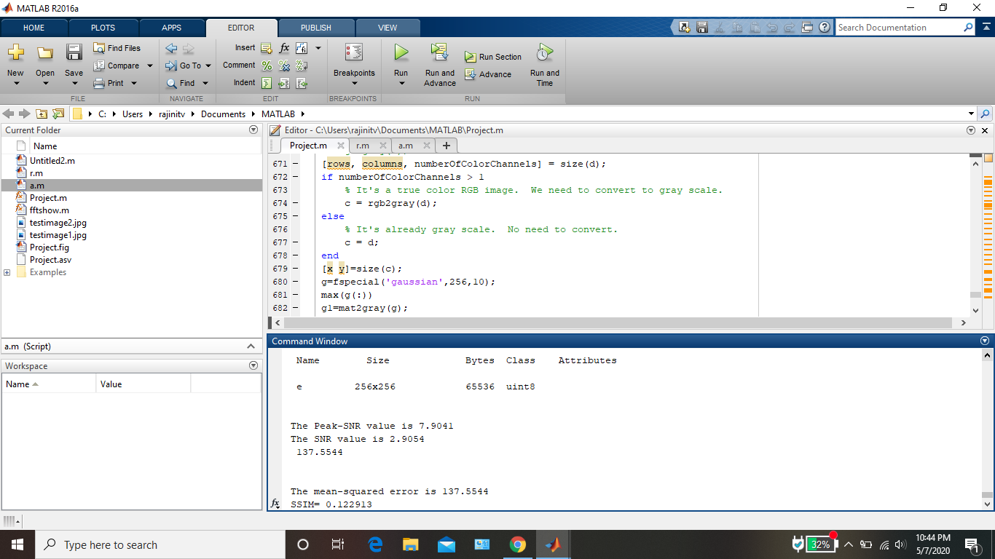
Image comparison metrics for LowPass filter

Slide 55
results
S.No | FILTER | MSE | PSNR | SSIM
1 | WIENER | 1.24 | 47.2192 | 0.9866
2 | AVERAGE | 6.142 | 36.7407 | 1
3 | MEDIAN | 1.67 | 45.9473 | 0.9882
4 | MIDPOINT | 7.81 | 39.23 | 0.957
5 | GUIDED | 6.82 | 39.8241 | 0.9484
6 | DISK | 36.08 | 32.592 | 0.736
7 | LAPLACIAN | 24.89 | 34.205 | 0.745
8 | MOTION | 12.61 | 37.158 | 0.913
9 | GAUSSIAN | 14.5 | 36.55 | 0.9116
10 | UNSHARP | 16.05 | 36.109 | 0.8944
11 | SOBEL | 216.75 | 24.805 | 0.138
12 | LOW PASS | 137.554 | 7.9041 | 0.1229
13 | RANGE | 219.68 | 24.7469 | 0.1893
14 | MAX | 0 | INF | 0.9053
15 | LOG | 222.72 | 24.687 | 0.1004
16 | MIN | 39.78 | 32.167 | 0.9051

Slide 56
APPLICATIONS:
Tumour detection
Inflammation or infection in an organ
musculoskeletal disorders
other irregularities that exist in tissue or organs in their body

Slide 57
Conclusion
This project makes it easy for the user to use the tool as it is designed using MATLAB GUI which contains several tools like the axes, panels, buttons etc. This GUI makes it easier for communicating with other user interface’s, create tables, plot graphs, performing computations etc. The user need not have any knowledge about the coding section working behind the GUI.
In our project when the load image push button is used, an image can be selected from any folder that is present in the MATLAB directory and will be displayed in the region of axes1. RGB to gray push button adjacent to it is used to convert a color image into a grayscale image and then displays it in the axes2 region.
A total of 17 filtering techniques can be applied using respective push buttons each provided for the filters like average, Laplacian, weiner, gaussian etc., and the filtered image will be displayed in the region of axes3.
Image comparison metrics like PSNR, MSE and SSIM are displayed in the command window of MATLAB for each filtered image. The values of these metrics are tabulated and can be compared.

Slide 58
FUTURE ENHANCEMENT
Cancer is the second leading cause of death world-wide and early detection of tumors could help in its effective treatment. This tool is useful to doctors in diagnosis phase for early detection of tumor to save the patient by appropriate treatment.
In future the image quality may be further enhanced by using hybrid filtering filtering techniques wherein two or more filters are used which may result in an excellent quality output which facilitates effective detection of lung cancer tumors.

Slide 59
References
https://www.who.int/nmh/publications/ncd_report_chapter1.pdf.
Pratap, G.P., & Chauhan, R.P. (2016). Detection of Lung cancer cells using image processing techniques. IEEE 1st International Conference on Power Electronics, Intelligent Control and Energy Systems (ICPEICES), 1-6.
Bariqi Abdillah, Alhadi Bustamam, and Devvi Sarwinda (2017). Image processing based detection of lung cancer on CT scan images. IOP Conf. Series: Journal of Physics: 893 (2017) 012063
Arvind Kumar Tiwari (2016). Prediction of lung cancer using image Processing techniques: a review. Advanced Computational Intelligence: An International Journal (ACII), Vol.3, No.1, 1-9.
Durge, J. M ., N. P. Bobade,, & Mhala. N. (2015). Image enhancement to detect the lungcancer at early stage using median filter. International Journal of Science, Engineering and Technology- Volume 3 Issue 4: 936-939.

Slide 60
THANK YOU

